Slide 1
To-Do List Project Title: "Efficient Task Management with To-Do Lists“ Instructor: MUZAHIR SALEEM
Presenter Name:
AAIMA GHALIB (S2023266115) CH. M. HASHIR (F2022065252)

Slide 2
Table of Contents:
Chaos of starting a new project
Abstract
Introduction
Technological overview
System Design
Main Window
Task Dashboard
Conclusion And Future Prospects

Slide 3
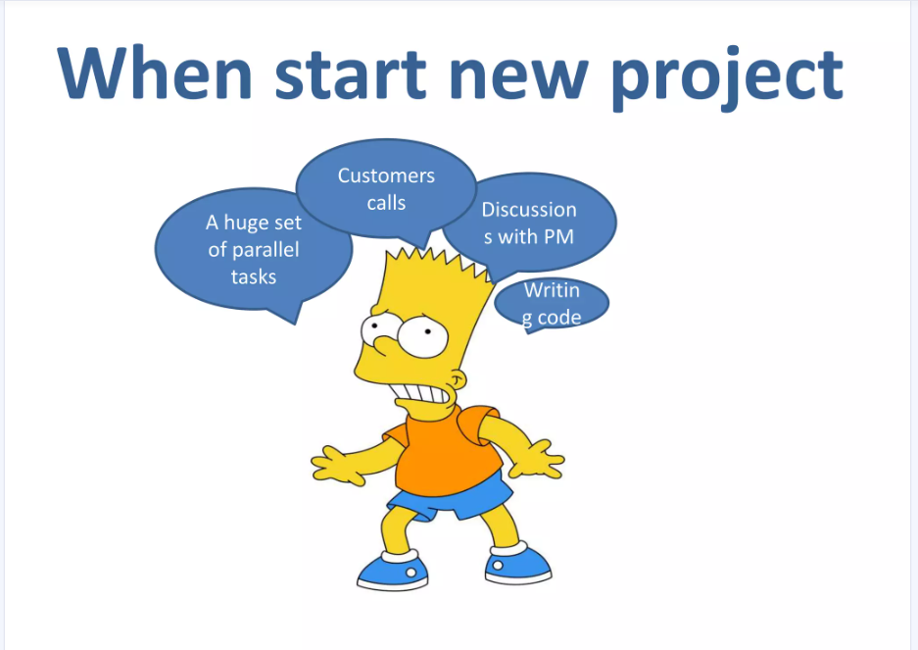
Chaos of starting a new project:
What can we do with
this?
There are many programs for time management which can help us.
We choose ToDoList because it has an extra simple user interface and free open source license

Slide 4
Abstract:
The 'To-Do List Website Using Web Technologies' project showcases a modern web-based application designed to simplify daily task management. By utilizing technologies such as HTML, CSS, JavaScript, BOOTSTRAP, PHP, and SQL, it offers a user-centric platform for creating, editing, organizing, and tracking tasks.

Slide 5
INTRODUCTION:
Purpose: Provide a streamlined, user-friendly solution to enhance personal productivity.
Key Objectives:
- Enable effective task management with CRUD operations.
- Offer a responsive, intuitive interface for users.
- Ensure data security through secure user authentication.

Slide 6
Technological Overview:
Frontend Framework:
- HTML: Structure and task organization.
- CSS: Design, responsiveness, and layout optimizations.
- JavaScript & jQuery: Interactivity and dynamic validation.
Backend Framework:
- PHP: Server-side logic and data operations.
- SQL: Structured data storage.
- AJAX: Real-time interaction and minimal server load.

Slide 7
System Design:
Core Architecture:
- Frontend Layer: Interactive UI created with HTML, CSS, and JavaScript.
- Backend Layer: Secure and efficient data processing through PHP.
- Database Layer: Structured data storage using SQL.
Operational Flow:
- User registration/login for personalized access.
- Task management with CRUD functionalities.
- Dynamic updates rendered through AJAX calls.

Slide 8
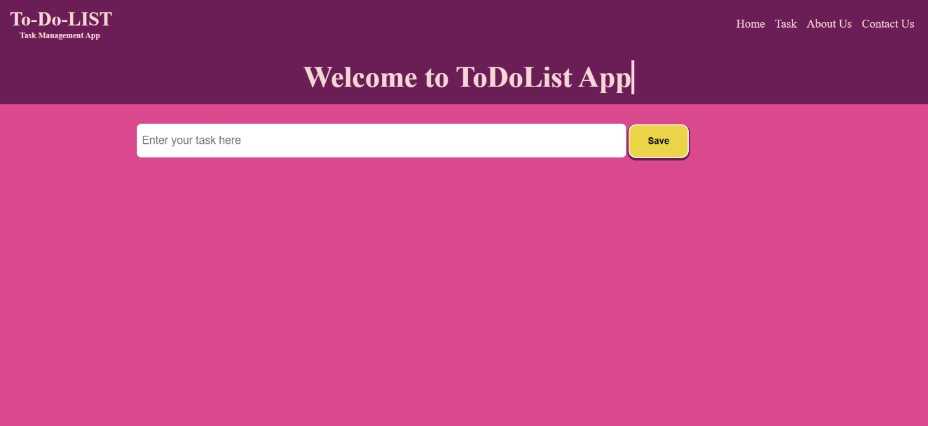
MAIN WINDOW:

Slide 9
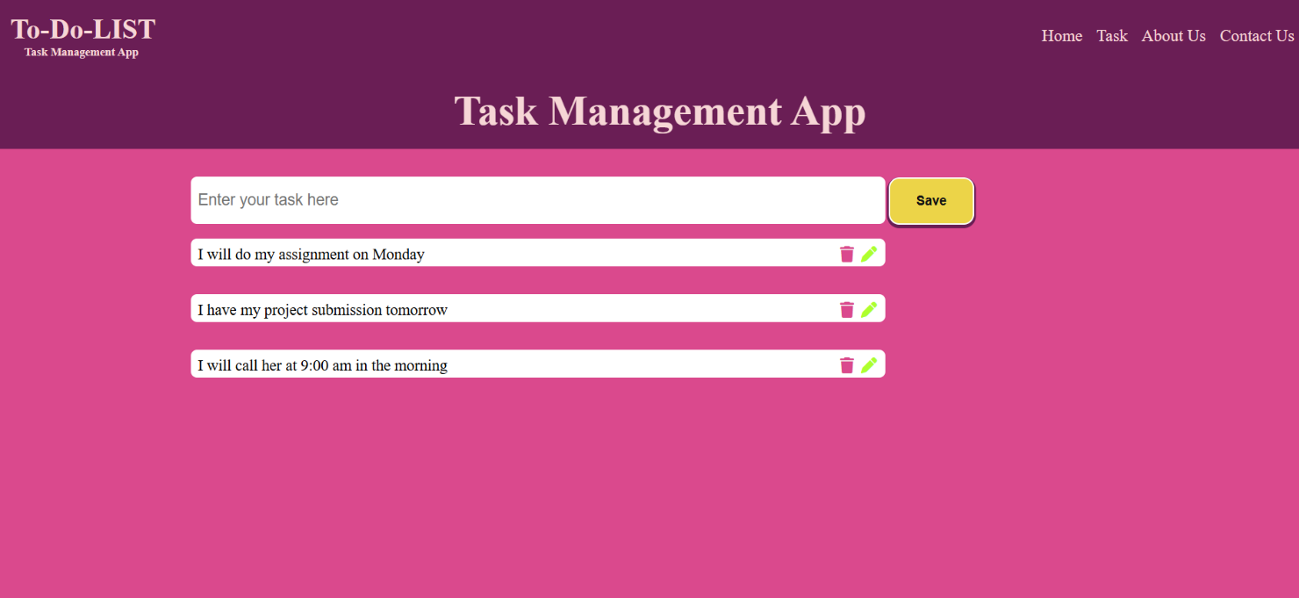
TASK DASHBOARD:

Slide 10
Conclusion and Future Prospects:
The To-Do List Website demonstrates the power of integrating web technologies to meet everyday organizational needs. Future upgrades include:
- Task reminders and push notifications.
- Strengthened data security measures.
- Enhanced customization and interactivity.

Slide 11
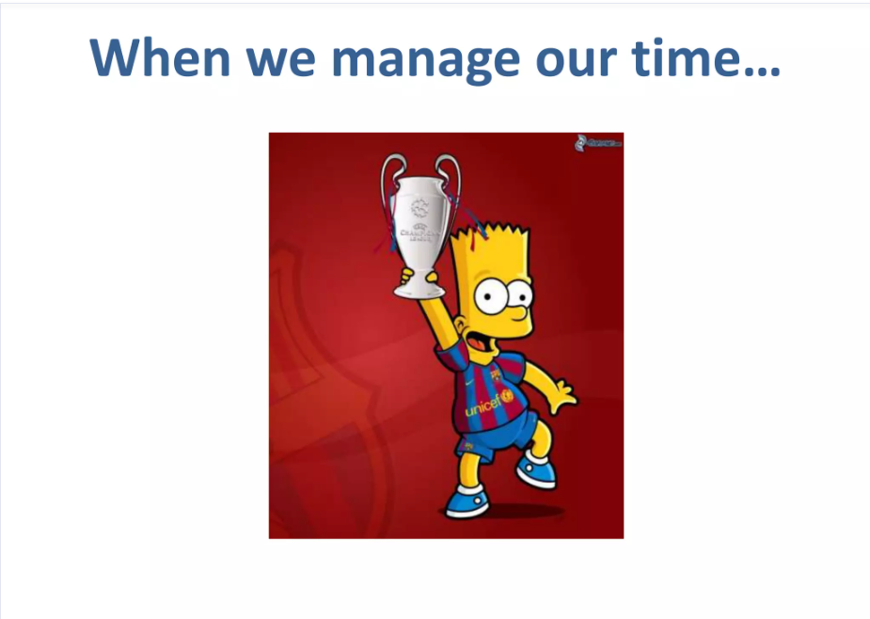
Thank you, Everyone! for your time and consideration
As well said by someone:
“We must use time as a tool, not as a couch.” ...

